Slide 1
The Tabernacle
Exposition of Exodus 25 & 26
Saturday PM 21st January 2017

Slide 2
Introductions
“The old is the new concealed…” - Augustine
The Tabernacle is very important to God
Exodus 25 – 40, Hebrews 9,

Slide 3
Overview
God instructed Moses to receive from the people a ‘willing’ offering
God stipulated the detail of the offering; gold silver, brass, blue, purple, scarlet, fine linen…
God wants to ‘dwell’ among His people

Slide 4
Items of Furniture
The Ark of the Covenant (or the Testimony)
The Mercy Seat
The Table of Show bread
The Golden Lampstand

Slide 5
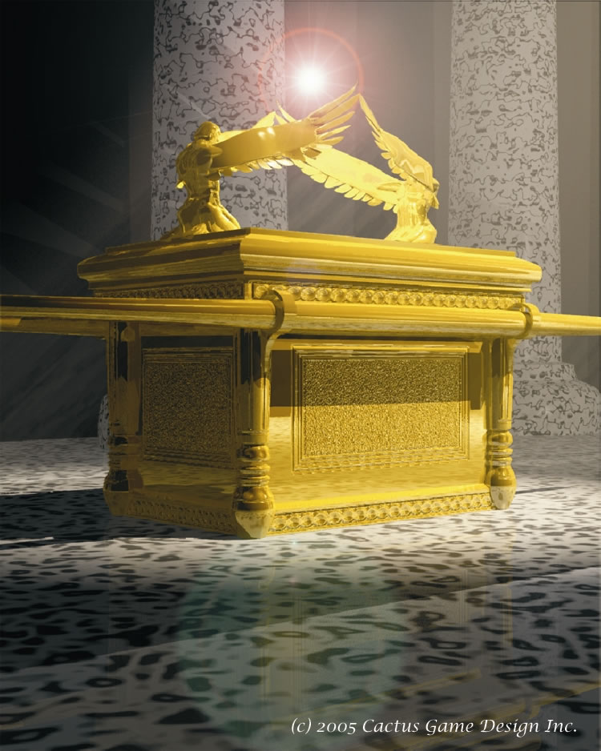
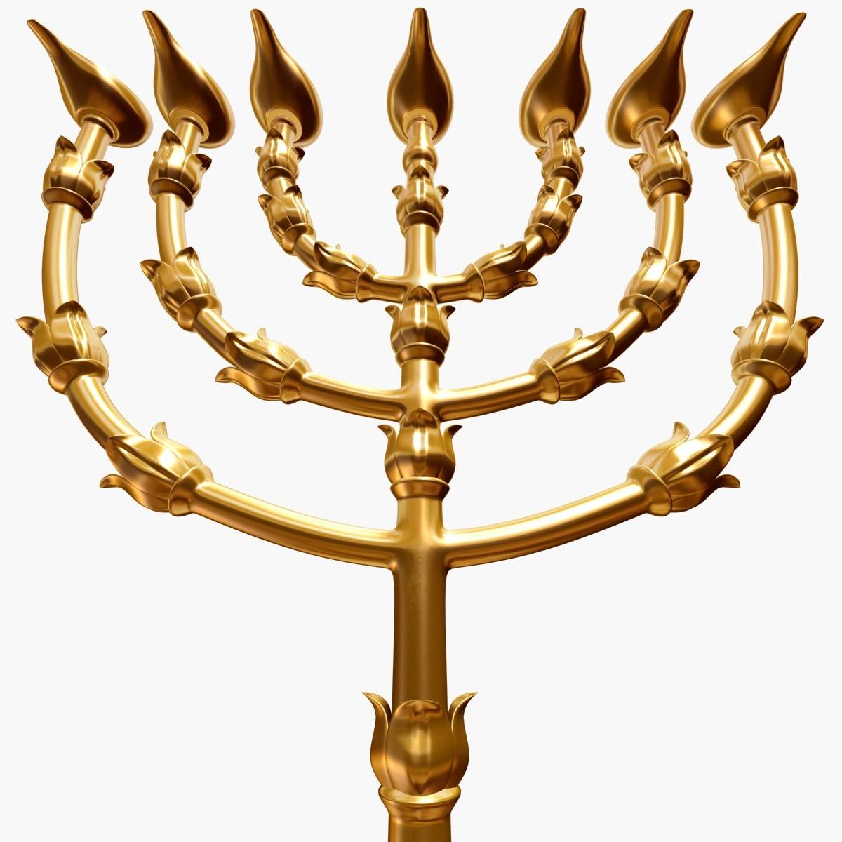
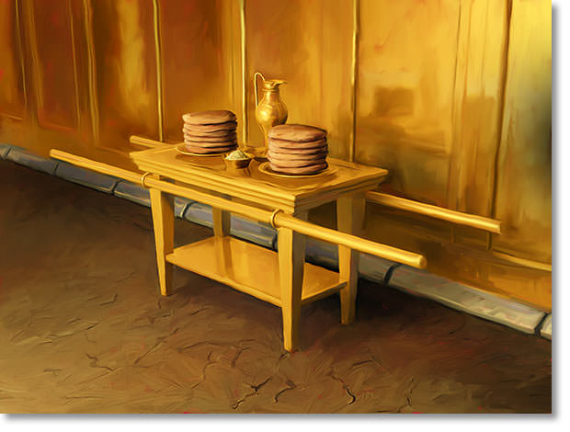
Items of Furniture

Slide 6
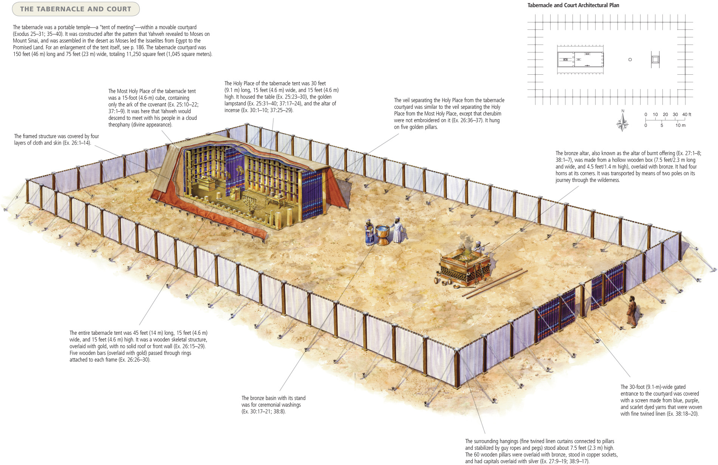
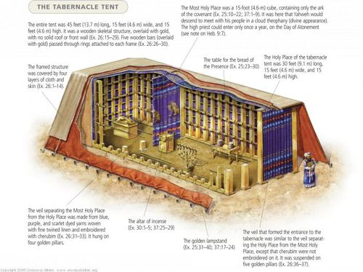
Items of Furniture

Slide 7
Symbolism of the Furniture
The Ark: the person of Jesus Christ
The Mercy Seat: the mission of Jesus Christ [Hebrews 2:17 and 1 John 4:10]
The Holy of Holies’ golden walls and cherubim curtains were illuminated only by the Presence of God

Slide 8
Symbolism of the Furniture
The Table of Show beard [John 6:32, 35]
The Golden Lampstand; which is the illuminating Word of God [Psalm 119:105]
The curtain or veil separating the two compartments of the Tabernacle

