Slide 1
The Tabernacle
Exposition of Exodus 27
Saturday PM 4th February 2017
“COMING IN FROM THE OUTSIDE”

Slide 2
Introductions
“The new is in the old concealed, and the old is the new revealed” - Augustine
The Tabernacle is very important to God
Exodus 25 – 40, Hebrews 8 and 9, Rev 21:1 – 5

Slide 3
Overview – Exodus 27
God instructed Moses to an Altar for the sacrifice of burnt offering – a square shape of acacia wood completely covered in Brass/Bronze
God gave the dimensions and detail of the utensils of the Altar
God specifies the dimensions and materials of the Court around in the Tabernacle

Slide 4
The Court around the Tabernacle

Slide 5
Dimensions of the Court

Slide 6
Dimensions and Materials
The Altar of Burnt Offering (the first piece seen by those entering the Court) was made of acacia wood, covering in brass and all the utensils were made of solid brass
The Court was 50m long and 25m wide; it had a curtain of fine linen on each side …see video

Slide 7
Dimensions and Materials
The Court had only one entrance facing EAST made with blue, purple, scarlet and fine linen – through which anyone wishing to enter had to COME IN; a clear depiction of the statement Jesus made about Himself in John 14:6 “I am the Way...”

Slide 8
Items of Furniture

Slide 9
Dimensions and Materials
The last thing mentioned in this chapter is God’s command for olive oil to be supplied by the people to ensure the light on the Golden Lampstand never goes out…

Slide 10
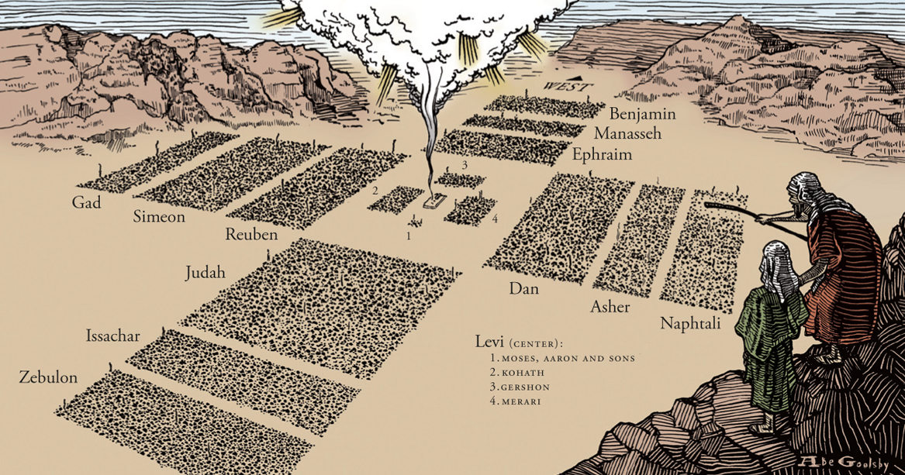
God Bless You

